Slide 1
Class 1: July 15, 2014 1:30 pm to 4:00 or 4:30 pm Introductions and Course Overview

Slide 2
Options in Number and Length of Classes
Option 1
12 classes
8:00 to 10:30 am and 1:30 to 4:00 pm
Last class July 29 (from 8:00 to 9:30 am)
Option 2
10 classes
8:00 to 11:00 am and 1:30 to 4:30 pm
Last class on Friday July 25 from 8:00 am to 10:00 am

Slide 3
Class 1: July 15, 2014 1:30 pm-4:00 or 4:30 pm
Introductions and Course Overview. Instructor introduction. Student introductions.
Housekeeping. Breaks.
Email: metrocoursebeijing@gmail.com
Handout: Student information sheet. Photo, Chinese name, English name, place of origin, career goal. Assignment of discussion groups. Assignment to a discussion groups.
Assignment 1: Group. Expectations from the course and report out

Slide 4
Class 1: July 15, 2014 1:30 pm-4:00 or 4:30 pm
Overview of the course. Walk through entire course syllabus in detail including class and project expectations.
Core Definitions for the Course
Assignment 2: Individual.

Slide 5
Instructor Introduction: Lyle D. Wray PhD
Born in Medicine Hat, Alberta, Canada
PhD at University of Manitoba, Winnipeg, Manitoba, Canada
Served as county manager in Minnesota USA
Headed regional think tank in Minnesota
Head a regional organization in Hartford, Connecticut, USA called Capitol Region Council of Governments. www.crcog.org
Been a frequent visitor to Asia since 1990

Slide 6
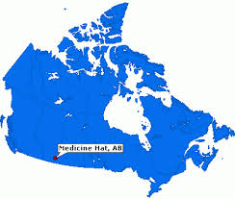

Slide 7
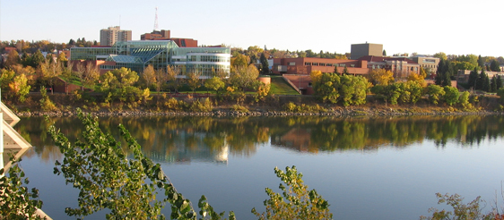

Slide 8
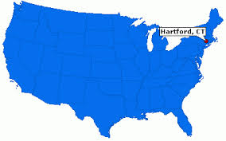

Slide 9
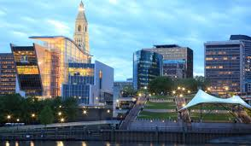

Slide 10
Class Member Introductions
Information sheet
Introduce yourself
Sheet to Teaching Assistant to form class list of members

Slide 11
Housekeeping
Start and stop times
Breaks

Slide 12
Contact Information
Course email: metrocoursebeijing@gmail.com
Email subject line: Name, group, assignment

Slide 13
Goals for the course
Familiarizing participants with the current realities of metropolitan areas in the global and U.S. context now containing a majority of the world's population and more than half of the global economy.
Define 'governance' and the governance challenges presented in the context of metropolitan regions in the 21st century in addressing a variety of challenges.
Identify and illuminate sets of metropolitan issues including housing, labor markets, transportation, environment and economic development.
Examine possible toolkits for addressing these challenges including land use and transportation planning, ICT, tax base sharing, soft and hard governance strategies and restructuring of government systems.

Slide 14
Outcomes for the class
Define and be able characterize the importance of metropolitan urban regions in global and local contexts;
Identify major dimensions of metropolitan urban regions including economic, environmental and social and the interplay among these dimensions;
Describe the relationship among policy agendas applied to metropolitan urban regions and the goals of economic, environmental and social development;
Describe major traditional tools of planning as applied in metropolitan areas in transportation, environmental, economic and social dimensions;
Describe major issues in metropolitan urban contexts and related strategies for these including growth management, sustainability in environmental, economic and social terms, and next generation economic development
Describe and offer examples of applications of emerging tools for managing major metropolitan issues including geographic information systems (GIS), strategic planning and performance measurement, evidence based management including the STAT, and predictive analytics systems as applied in metropolitan regions;
Describe emerging issues, future possibilities and next generations strategies including “smart cities and regions”, Web 2.0, and “big data”.

Slide 15
Assessment of Student Learning Outcomes
Course members may earn a maximum of 100 points in the class:
Course project Total of 30 points
Course project presentation Total of 20 points
Class participation Total of 25 points
Open book examination Total of 25 points
Total maximum points is 100

Slide 16
Two types of course projects
Tools for metropolitan regions. Select a tool or portfolio of tools, the applications that they have been put to, how they contribute to a better metropolitan region, and next steps in the evolution and use of the tool. Examples of tools include: advanced scenario planning, geographic information systems, data analytics including "smart cities" tools, data based decision making including the STAT program and predictive analytics. Other examples of tools will be discussed in class and further suggestions offered.
Issues in metropolitan regions. Describe issue, related elements, approaches to the issue, best practices, applications in the national context, and next steps. Examples include public transit and urban mobility systems, environmental protection and restoration, and place making. Both a problem analysis and a policy analysis are expected for the issues described. Problem analysis: A description of the problem that the policy or program is attempting to remediate including data on who is impacted, its size and scope. The paper should identify assumed causes of the problem that the policy is intended to solve. Policy analysis: Discuss the history of the issue. Explain which events triggered the demand fo resolution of the issue. How effective are existing policies and why is change needed? What alternatives were considered? Why is the recommended policy or program preferred over the other options? What are implementation challenges? What are the potential unintended consequences? How should the effects of the program or policy be monitored?

Slide 17
Four Steps in a course project
1. Select a topic or issue. After sharing in assigned discussion group and approval of the instructor, select a topic that includes a description of the tool, issue or geographic area.
2. Write an outline of the project. Outline of major sections of the paper with one or more sentences description in the major headings and references.
3. Submit draft paper for feedback from assigned discussion group and instructor.
4. Submit final paper and present the paper to the class and instructor. Guidance on presentation will be offered in the class to all course members.

Slide 18
Overview of the course materials -- Why study metropolitan regions?
Growth in metropolitan urban regions is accelerating in China and other parts of the world
Most of the world economy is generated in and passes through a limited number of metropolitan regions
Mobility for people and goods is focused in and through metropolitan regions
Much of the economic innovation is developed in and applied in a limited number of metropolitan regions
With a majority of global population, managing the environment – air, water, bio diversity – in metropolitan regions becomes very important

Slide 19
What is metropolitan governance?
Governance is much broader than government
Governance is the way a society – metropolitan region – identifies, responds to, organizes and addresses challenges including but more than government
Challenges include: economy, education, health, mobility, environmental quality and many more
Centralization and decentralization styles of governance
Market and non market elements including nongovernmental, non business organizations
What are effective ways of governance in metropolitan regions?

Slide 20
Assignment 1: Group
Group Assignment 1: What are your expectations for the class? What do you hope to learn? How might you apply this material in a future job?
Recorder for the group: Select one person to present the discussion notes and email them after the class
Report out to the class: Each of the groups reports and there is discussion
After class, recorder please email with your name, group number and Assignment 1 in subject line to: metrocoursebeijing@gmail.com

Slide 21
Class 2: Metropolitan Regions in Global Context
Overview of metropolitan urban regions in global context. The rise and significance of metropolitan urban regions and the significance that such regions play in economic and social development. What are metropolitan regions: Metropolitan urban regions defined. Why are metropolitan regions important? What are important metropolitan regional issues? World urbanization tipping point in 2000. Massive increase in 20 million person urbanized areas. Mega-regions in EU and US. Trends in urbanization: rural, urban, suburban, polycentric, linked polycentric urbanized areas.

Slide 22
Class 3: Urbanization and Economic Development
Urbanization and Economic Development. Economies.
Commodities economy – few people with abundant natural resources and relatively small populations (e.g. Canada, Australia, New Zealand, Norway);
Talent economy – Switzerland, Japan, Germany.
Export driven economies - Value added export driven Asian Tigers evolving toward consumption driven economies.
Consumer economies – advance economies where population consumption is the majority of the economy.
Relationship of metropolitan urbanization and economic development. Post industrial, consumer societies with high value added production.

Slide 23
Class 4: Planning and Urban Planning
Definition of planning and urban planning. Value added from planning? Coordination of complex activity (see Drucker on large scale organizations), large scale enterprise. ICT as facilitator.
1922 Athens declaration – city as machine, segregation of uses, zoning as core tool.
1939 World’s Fair in New York City: Futurama – still living in the aftershock of that view globally.
Planning layers: natural, infrastructure, population as GIS layers. Planning and urban form. Purpose of planning. Limits of planning – part of a cycle of vision, planning, implementation and correction. Plan your work and work your plan.
Triple bottom line: environmental, economic and social.
Balanced scorecard in business. Implementation of plans: capacity and other factors.

Slide 24
Land Use Planning
Land Use Planning. Purposes of land use management. Segregation of uses, orderly operation. Growth management. Urbanization, suburbanization, poly centric networked form. Urban form early on in east and west.
1800s. Paved streets, sidewalks, sewers, water treatment systems, street lighting, police, public transport.
1920s city as machine, specialization of function, segregation of uses (based on then common uses).
1940s auto centered culture and urban form. Futurama 1940. 1956 interstate highway system (Germany 1930 autobahn). Two trillion US dollars in auto infrastructure. Zoning. 1920 history. Segregation of uses in earlier economic stage. Stimulated low density environments. From segregated uses to mixed use, mixed income, transit oriented development. Edgeless City study in Hartford Metropolitan region – three corridors and reduced CO2 emissions. Modernized zoning for sustainability and economic vitality. Sustainable Knowledge Corridor templates for communities to use.

Slide 25
Class 5: Transportation and Infrastructure in Metropolitan Urban Areas
Transportation and Infrastructure in Metropolitan Urban Areas. Movement of goods and of people.
Greenhouse gas emissions per weight of cargo or per trip: water, rail, and truck. Metropolitan regional transportation systems.
Mega-regional scale transportation systems. Infrastructure: HSR, freight and logistics, and broadband. Transportation planning: modes, intermodal linkages and optimization versus capacity building.
Presentation of proposed course projects for feedback.

Slide 26
Class 6: Economic Development in Metropolitan Areas
Major stages of economic development and role of metropolitan urban regions in each.
Education. Austria Maria Theresa primary school 1700s, Prussia. 1787 USA. 1865 Morrill Act. 1945 GI Bill. Research and development. US history. 1787 universal education. 1864 Morrill Act for higher education. 1945 GI bill for higher education. National development.
Comprehensive Economic Development (CEDS) plans. Seattle Puget Sound example: talent, infrastructure, value added. Stages of economic development and role of urban areas in each of these.
Polycentric urban areas: broadband, high speed rail and air links. Economic. Stages. Post Industrial age. Hunting and gathering. Agriculture. Industrial revolution, Postindustrial – ICT, networks, bio pharmaceutical revolution. Second industrial revolution. Early days of ICT and bio pharmaceutical revolution. Resource based economies: small numbers, high value commodities, good governance.
First open book examination on course content.

Slide 27
Class 7: Environmental Planning in Metropolitan Areas
Environmental Planning in Metropolitan Areas. 1960s environmental impact movement. 1970s Environmental regulation of air, water, and other toxic emissions. Massively successful in US and EU, Canada, Australia and New Zealand. Metropolitan regional scale in environmental management. Drinking water, waste water, air quality, energy production. Greenhouse gas inventory and mitigation strategies per metropolitan urban region in the EU. LEED buildings and neighborhoods.
Green infrastructure, product life-cycle design and product stewardship, recycling and reuse. Materials management and design. Sustainable metropolitan urban form. UN definition of sustainability. Major dimensions: CO2, air quality, water quality, natural environment preservation such as watersheds, animals, plants. Tools LEED certification of buildings and now neighborhoods. Green infrastructure. Green energy. Green materials management including product stewardship, life cycle design of products.

Slide 28
Class 8: Metrics and Data-Based Decision Making
Metrics and data-based decision making. Regional quality of life metrics. Maslow’s hierarchy of needs: from survival to self-actualization. Quality of life issues, OECD, Legatum foundation. Metrics. Issue, stages of public opinion Yankelovich. “Como vamos” project in Latin America; municipal services in India. Jacksonville Community Council. Outcomes and performance measurement and management systems. Indicator systems at regional level. STAT systems at regional and state levels. Impacts of key drivers on metropolitan level systems. Citizen engagement in policy and operations of urbanized areas: SeeClickFix.com, Mind Mixer, and Results That Matter book. Evidence based practice in health care, management and public services.

Slide 29
Class 9: What is Next in Metropolitan Urban Regions?
Major drivers: urbanization, population growth, and demographic transformations.
Focus on several drivers in this course. ICT revolution soaking through the world. Biogenetic pharmaceutical revolution just starting. DNA 1958, human genome 50 years later, first synthetic DNA. Materials management. Carbon fiber, fiber optics, 3D printers, laser guided fabrication. Smart city. Green infrastructure, green buildings and green cities.
Tools: Advanced Scenario Planning Tools. Envision Tomorrow. Consequences of various development decisions in 12 outcomes areas. Change behavior.

Slide 30
Class 10: Presentation of course projects. Course wrap up.
Presentation of course projects.
Course wrap up. Next generation urbanization issues, tools and strategies. Looking ahead to challenges globally and locally. Social equity. Inclusion. Income, age, ethnicity.
Emerging issues, tools and strategies. 22nd century metropolitan urban regions (e.g. smart cities by Siemens, IBM and other firms). Sensors, decision support systems, STAT, predictive analytics, responsive public services (SeeClickFix.com). Transit oriented development, walkability metrics, "place making".
Major tools for managing metropolitan urban regions: broad policy tools (e.g. urban growth boundaries and limits…), technical tools GIS, modeling, data analytics, data driven decision systems, and evidence based practice. Draw out local implications. End of class celebration.

Slide 31
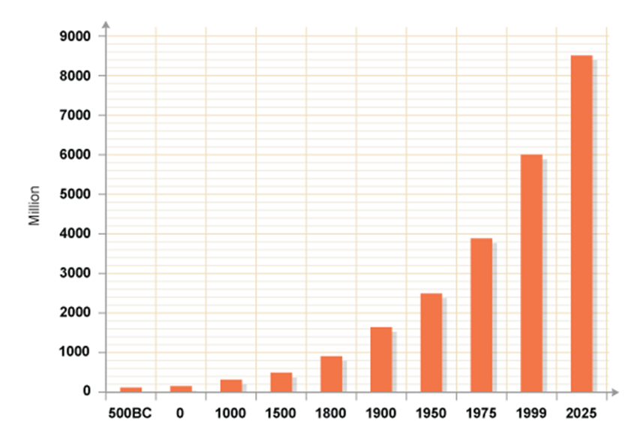
Background: World Population Growth

Slide 32
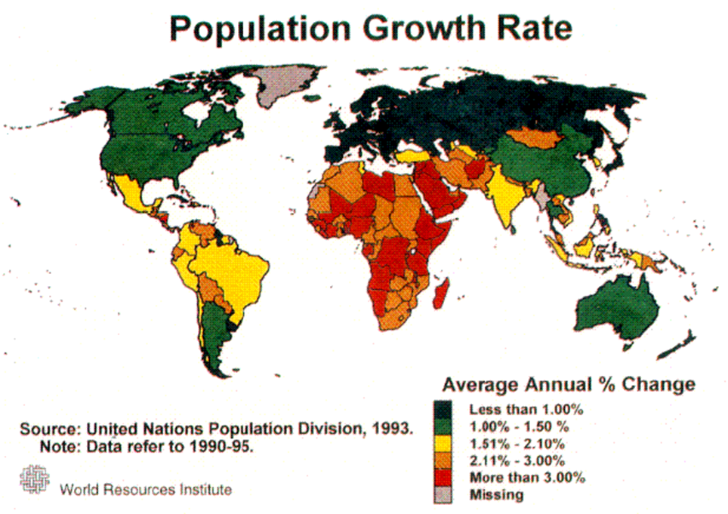
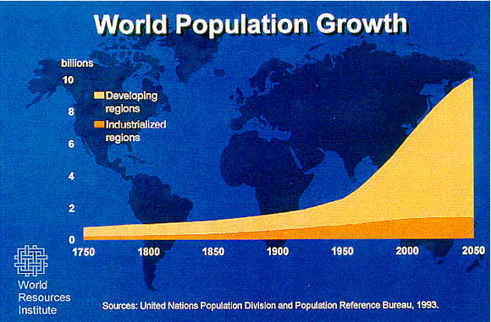
World Population Growth

Slide 33
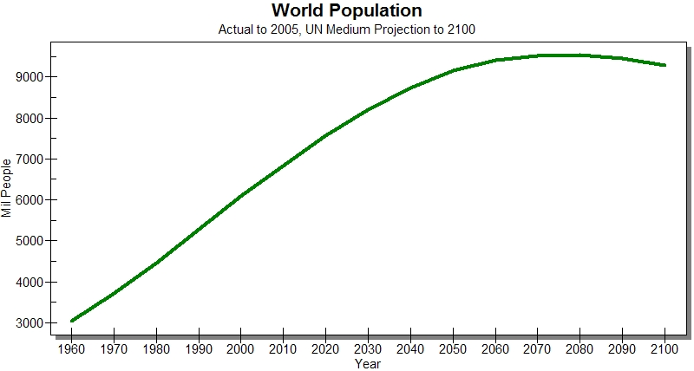
World Population Growth

Slide 34
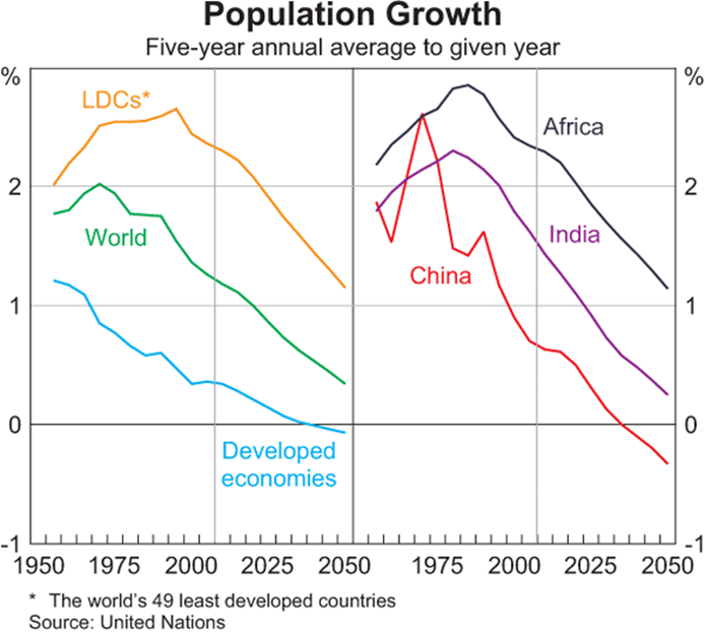
World Population Growth

Slide 35
Core Definitions for the Course
Metropolis
Metropolitan region
Metropolitan economy
Economic innovation
Sustainable development

Slide 36
Metropolis
A very large or important city. The chief or capital city of a country, state, or region. The term is Greek and means the "mother city" of a colony.

Slide 37
Metropolitan Region
A metropolitan area combines an urban agglomeration (the contiguous, built-up area) with zones not necessarily urban in character, but closely bound to the center by employment or other commerce.
These outlying zones are sometimes known as a commuter belt, and may extend well beyond the urban zone, to other political entities.
Term metropolitan regions adopted in the US in 1950.
A polycentric metropolitan area is one not connected by continuous development or conurbation, which requires urban contiguity. In defining a metropolitan area, it is sufficient that a city or cities form a nucleus that other areas have a high degree of integration with.

Slide 38
Metropolitan Regions
World is now majority metropolitan regional urban population
USA is major suburban since 1990

Slide 39
Why study metropolitan regions?
Growth in metropolitan urban regions is accelerating in China and other parts of the world
Most of the world economy is generated in and passes through a limited number of metropolitan regions
Mobility for people and goods is focused in and through metropolitan regions
Much of the economic innovation is developed in and applied in a limited number of metropolitan regions
With a majority of global population, managing the environment – air, water, bio diversity – in metropolitan regions becomes very important

Slide 40
What is metropolitan governance?
Governance is much broader than government
Relates to how a society – metropolitan region – identifies, responds to, organizes and addresses challenges
Challenges include: economy, education, health, mobility, environmental quality and many more
Centralization and decentralization styles of governance
Market and non market elements including nongovernmental, non business organizations
What are effective ways of governance in metropolitan regions?

Slide 41
Measures of Good Governance
Effective
Efficient
Responsive

Slide 42
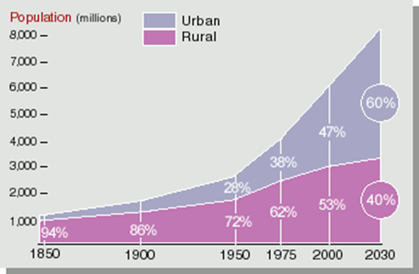

Slide 43
Economy
600 urban centers generate about 60 percent of global GDP (McKinsey)
Animation globe: http://www.mckinsey.com/tools/Wrappers/Wrapper.aspx?sid={C84CB74F-A3B1-47B1-8265-6252F6D85B68}&pid={4F5BEDB1-6C1F-4243-A052-83ADBABE82DF}

Slide 44
Metropolitan Economy
A metropolitan economy refers to the cohesive, naturally evolving concentration of industries, commerce, markets, firms, housing, human capital, infrastructure and other economic elements that are comprised in a particular metropolitan area.
A metropolitan economy encompasses all interdependent jurisdictions of particular regional clusters.
Metropolitan economies are competing globally in specialized sectors and fields tailored to their regional clusters of industries and firms.

Slide 45
Economic Innovation
The introduction and dissemination of a new idea, product, or technological process throughout society and the economy.
The innovation process should be contrasted with the act of invention, which is the creation of something new, but not the dissemination.
Applies to all aspects of society and the economy--physical, tangible, cultural, and social.
Innovation often leads to the widespread use of new products (such as computers and DVD players), but it also creates new cultural, social, and economic institutions (such as government agencies, forms of business organizations, and social trends).
Innovations are consider to be a primary source of economic growth.

Slide 46
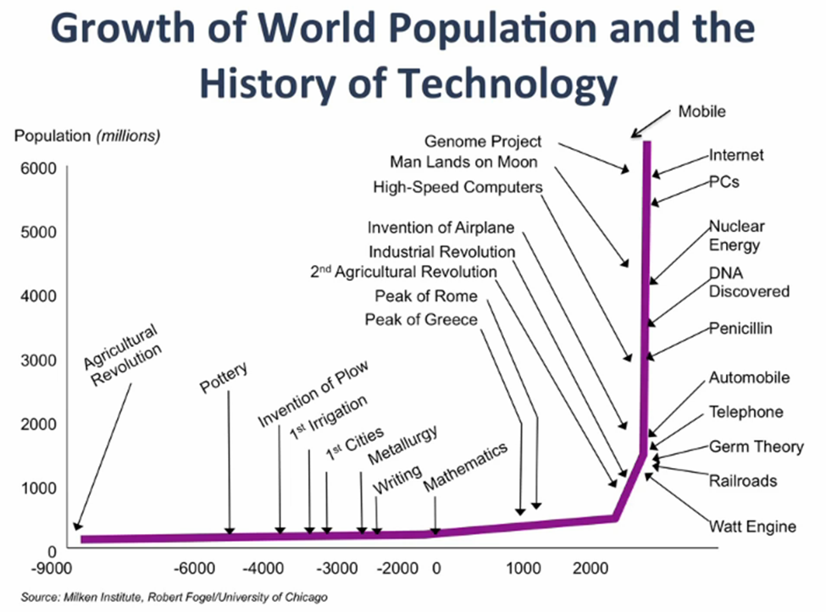

Slide 47
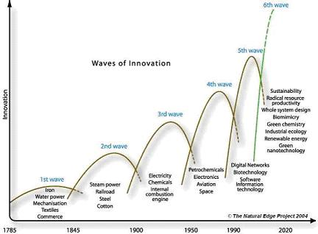
Waves of Innovation since 1785
6th wave
Iron
Water power
Mechanization
Textiles
Commerce
5th wave
4th wave
Innovation
3rd wave
2nd wave
1st wave
1785 1845 1900 1950 1990 2020
Source: Hargroves, K. and Smith, M. (2005), p 17.

Slide 48
Waves of Innovation since 1785
6th wave
Steam power
Railroad
Steel
cotton
5th wave
4th wave
Innovation
3rd wave
2nd wave
1st wave
1785 1845 1900 1950 1990 2020
Source: Hargroves, K. and Smith, M. (2005), p 17.

Slide 49
Waves of Innovation since 1785
6th wave
Electricity
Chemicals
Internal combustion engine
5th wave
4th wave
Innovation
3rd wave
2nd wave
1st wave
1785 1845 1900 1950 1990 2020
Source: Hargroves, K. and Smith, M. (2005), p 17.

Slide 50
Waves of Innovation since 1785
6th wave
Petrochemicals
Electronics
Aviation
Space
5th wave
4th wave
Innovation
3rd wave
2nd wave
1st wave
1785 1845 1900 1950 1990 2020
Source: Hargroves, K. and Smith, M. (2005), p 17.

Slide 51
Waves of Innovation since 1785
6th wave
Digital Networks
Biotechnology
Software
Information technology
5th wave
4th wave
Innovation
3rd wave
2nd wave
1st wave
1785 1845 1900 1950 1990 2020
Source: Hargroves, K. and Smith, M. (2005), p 17.

Slide 52
Waves of Innovation since 1785
6th wave
Sustainability
Radical resource productivity
Whole system design
Biomimicry
Green chemistry
Industrial ecology
Renewable energy
Green nanotechnology
5th wave
4th wave
Innovation
3rd wave
2nd wave
1st wave
1785 1845 1900 1950 1990 2020
Source: Hargroves, K. and Smith, M. (2005), p 17.

Slide 53
Environment
Most people live in metropolitan urban regions
Air, water, greenhouse gases and other elements
Preservation of environment for aesthetic and environmental reasons

Slide 54
Sustainable Development
The term, sustainable development, was popularized in Our Common Future, a report published by the World Commission on Environment and Development in 1987. Also known as the Brundtland report, Our Common Future included the “classic” definition of sustainable development:
“Development which meets the needs of the present without compromising the ability of future generations to meet their own needs.”
Reference: http://www.un.org/wcm/webdav/site/climatechange/shared/gsp/docs/GSP1-6_Background%20on%20Sustainable%20Devt.pdf

Slide 55
Sustainable Development
Sustainable Development: “development which meets the needs of the present without compromising the ability of future generations to meet their own needs.”
Sustainable Knowledge Corridor project in Connecticut and Massachusetts: http://sustainableknowledgecorridor.org/

Slide 56
Social Factors
Social organization: hutongs, regional government
Income inequality issues
Economic and social advancement: expectations
Evolution of forms of social organization

Slide 57
What is next for metropolitan regions?
Much more urban environment in the world
ICT soaking into all aspects of life
Sensing systems in cities and regions in real time: transit, water, air quality
Decision making in real time: STAT programs and others for management
Responses through ICT: disaster through mobile apps and webpages

Slide 58
Smart Cities, Smart Regions
*IBM A vision of smarter cities: http://www- 31.ibm.com/solutions/cn/government/downloads/GBE03227USEN.PDF
Smart cities. Geolocation. http://goo.gl/K2w1QX Slideshare
Smart cities. Delivering smart cities. Slideshare. urbanization trends, location of urbanization. http://goo.gl/AhzOjD
Smart cities. Big data. http://goo.gl/VEieyx Slideshare
Smart cities. EU Danube. http://goo.gl/YfH7Ep Slideshare
Big data and air pollution: http://qz.com/230689/how-ibm-is-using-big-data-to-fix-beijings-pollution-crisis/

Slide 59
Design and Quality of Life
Singapore
Seoul
Zurich
IDEO
Design
Metrics
Value added

Slide 60
Class Wrap Up
Main highlights of the class
Group assignment 1
Group assignment 2
Preview of class 2
Questions and answers
End of class

Slide 61
Assignment 2: Individual
What was the most surprising thing that you heard today in the course overview?
Email with your name, group number and Assignment 1 in subject line to: metrocoursebeijing@gmail.com

Slide 62
Assignment Summary
Assignment 1: Group. What are your expectations for the class? What do you hope to learn? How might you apply this material in a future job? Email with your name, group number and Assignment 1 in subject line to: metrocoursebeijing@gmail.com
Assignment 2: Individual. What was the most surprising thing that you heard today in the course overview? Recorder for the group email the group number in subject line to: metrocoursebeijing@gmail.com

Slide 63
Course Resource Materials
Shantini http://goo.gl/emfomz
Calgary Metropolitan Plan. http://www.slideshare.net/CalgaryRegion/calgary-metropolitan-plan?qid=48107333-365b-42d5-be03-a286bdf1940f&v=default&b=&from_search=12
Calgary Growth Management Plan. http://www.slideshare.net/TownofHR/growth-management-strategy-second-public-open-house
Calgary Regional Partnership. Indicators for Measuring Progress. http://www.slideshare.net/CalgaryRegion/calgary-metropolitan-plan-performance-indicators-report?qid=c46cf6b0-51ca-4312-84b0-495fc3a2752d&v=qf1&b=&from_search=6
Calgary Regional Transportation Plan Update. http://www.slideshare.net/CalgaryRegion/regional-transportation-program-update-2012
Achieving Sustainable Regions and Communities in Southern New England. http://www.slideshare.net/APA-MA/achieving-sustainable-regions ***
World urbanization prospects. United Nations. http://www.slideshare.net/undesa/wup2011-highlights
World’s biggest megacities. 2012 http://www.slideshare.net/yaryalitsa/the-worlds-biggest-megacities-according-to-allianzcom-december-2012?qid=7581629e-e25f-48f6-be4f-09dbacecf91e&v=default&b=&from_search=1
Smart cities. Geolocation. http://goo.gl/K2w1QX Slideshare
*Smart cities. Delivering smart cities. Slideshare. urbanization trends, location of urbanization. http://goo.gl/AhzOjD
Smart cities. Big data. http://goo.gl/VEieyx Slideshare
Smart cities. EU Danube. http://goo.gl/YfH7Ep Slideshare
Land use planning. Slideshare. http://goo.gl/Ye5yTJ

